Slide 1
Urban Cleaning
Challenges to smart cities
Cascais – 29/09/2017
Luc De Rooms – City Maintenance and Waste
City Of Antwerp - Belgium

Slide 2
Houston, Do we have a problem?
Shopping street on a Friday evening
18:00
Antwerp
Belgium

Slide 3
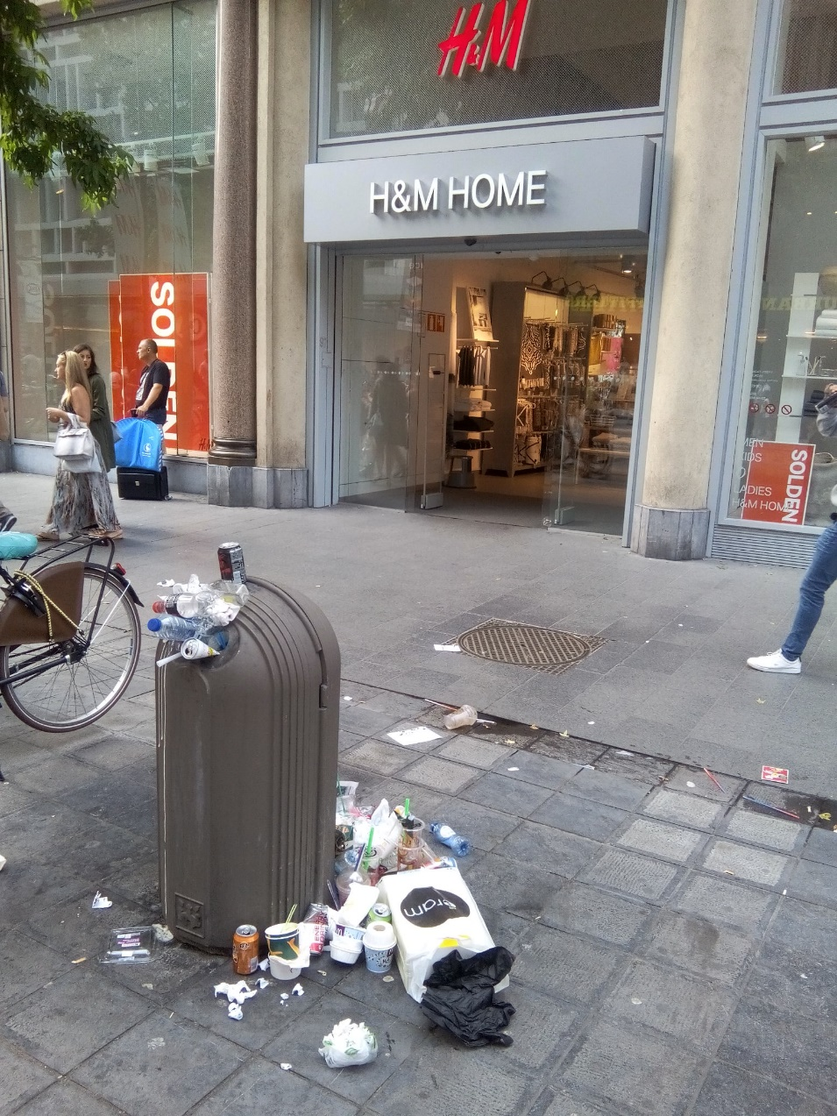
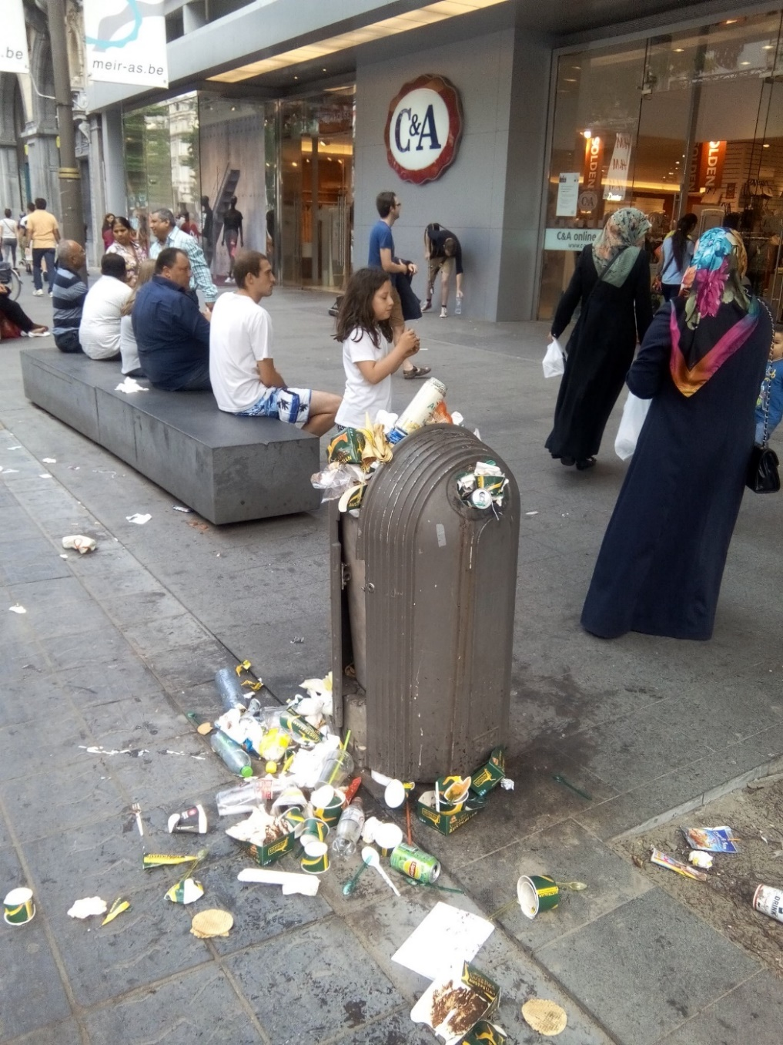

Slide 4
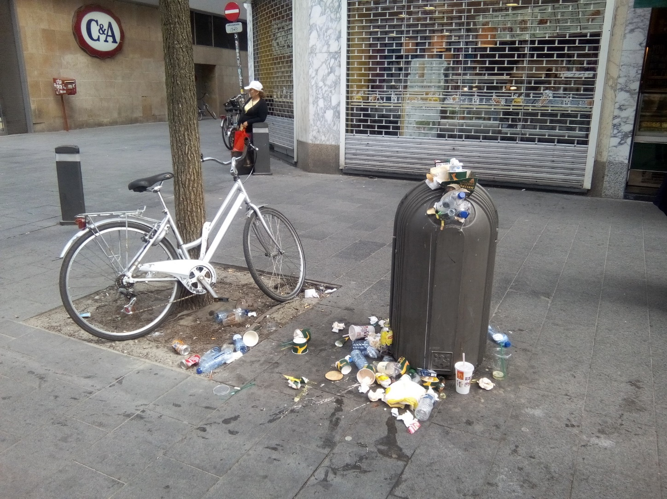
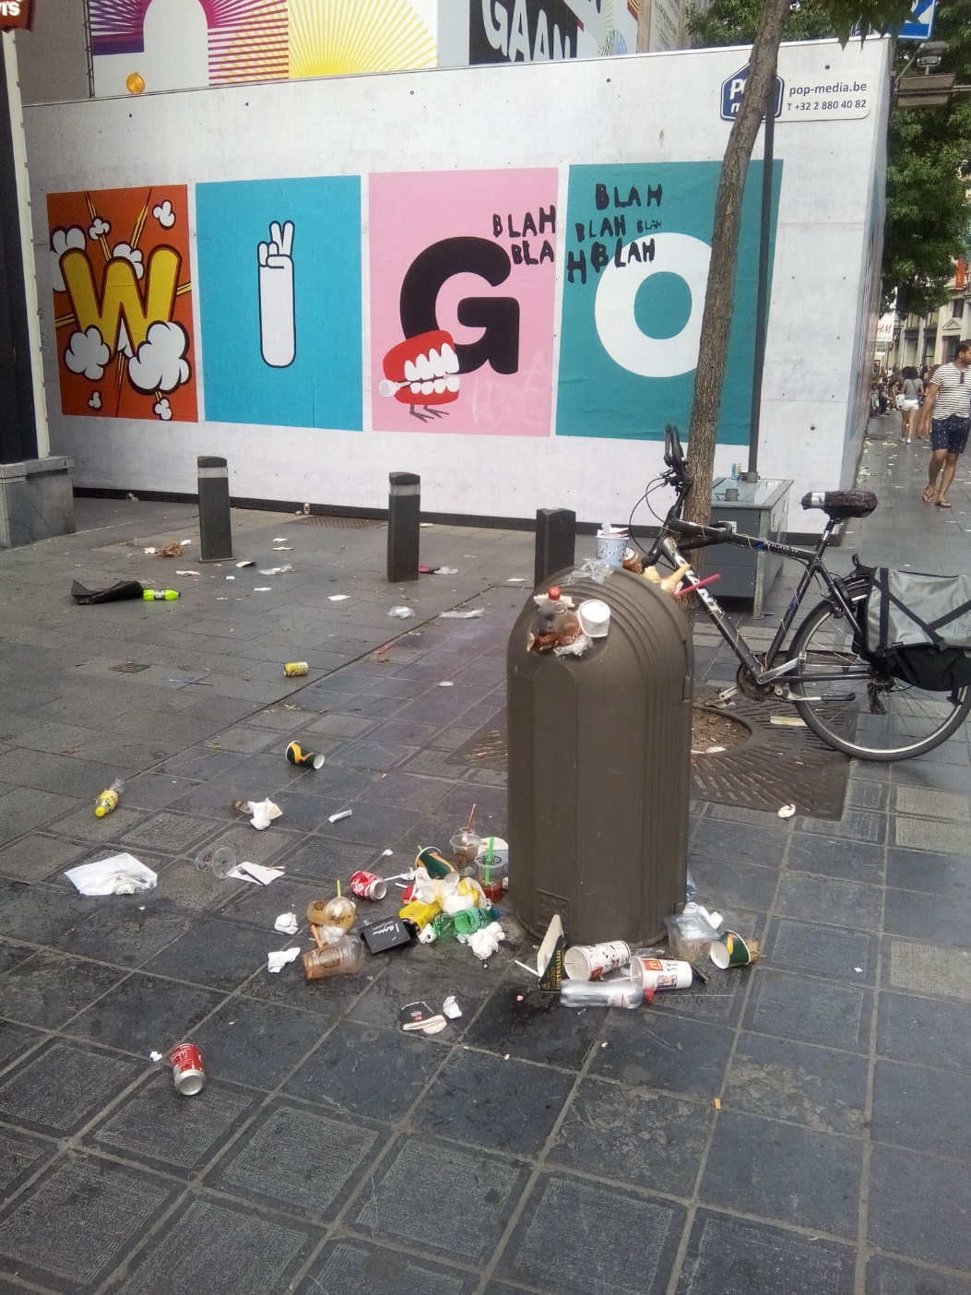

Slide 5
Houston, Do we have a solution?
Our cleaners passed there already 3 times that day…
Planning workers and machines?
  How much do they have to pass? 4 – 5 … … - 9 times?
  And in winter or snowy and rainy days: playing the cards? Keeping them busy?
One of our work leaders said last month: “We give a bad signal by cleaning streets every day.”

Slide 6
City of Antwerp
City of Antwerp
522.000 inhabitants
100.000 workers every week day into the city
172 nationalities (big Harbor tradition)
40.000 students
Up to 150.000 tourists a day in city center on Sunday shopping and summer or Christmas events

Slide 7
City of Antwerp: 457 people for cleaning
Zwerfvuil
 | Personeel
 | Categorie | Aantal | Reële jaarlijkse loonkost | Personeelskost
 | werkleider C4-5 | 4 | € 72 101,44 | € 288 405,76
 | ploegleiders C1-3 | 23,5 | € 56 086,15 | € 1 318 024,53
 | chauffeurs D | 83,5 | € 48 775,60 | € 4 072 762,60
 | machinale veger E | 161 | € 41 137,00 | € 6 623 057,00
 | manuele veger E | 185 | € 41 137,00 | € 7 610 345,00
 | Krinkels zwerfvuil |  |  | € 120 000,00
 | Werkhaven vegen |  |  | € 1 641 383,00
 | Totaal | 457 |  |  |  |  |  | € 21 673 977,89
 | Materiaal
 | Categorie | Aantal | Aankoopprijs | Investeringskost | Exploitatiekost | Totale kost | Jaarlijkse kost (10j)
 | veegmachine klein | 11 | € 98 488,00 | € 1 083 368,00 | € 2 166 736,00 | € 3 250 104,00 | € 325 010,40
 | veegmachine middel | 30 | € 119 056,00 | € 3 571 680,00 | € 7 143 360,00 | € 10 715 040,00 | € 1 071 504,00
 | veegmachine groot | 17 | € 210 000,00 | € 3 570 000,00 | € 7 140 000,00 | € 10 710 000,00 | € 1 071 000,00
 | bachewagen | 72 | € 34 700,00 | € 2 498 400,00 | € 4 996 800,00 | € 7 495 200,00 | € 749 520,00
 | toezicht | 20 | € 15 000,00 | € 300 000,00 | € 600 000,00 | € 900 000,00 | € 90 000,00
 | zwerfvuilzuiger | 18 | € 20 000,00 | € 360 000,00 | € 0,00 | € 360 000,00 | € 36 000,00
 | Totaal |  |  |  |  |  |  | € 3 343 034,40
 | Afvalverwerking
 | Fractie | Tonnage | Prijs per ton | Kostprijs verwerking
 | Restafval | 5369 | € 113,34 | € 608 476,86
 | Totaal |  |  |  |  |  |  | € 608 476,86
 | TOTAAL ZWERFVUIL |  |  |  |  |  |  | € 25 625 489,15

Slide 8
4200 bins – 4050 “normal” – 120 Big Belly’s
About 5 million to add (on the 25 million) => 30 million EUR a year !
  16 trucks – 7 days a week – to empty bins
  About 30 drivers/ 30 loaders
  Treated as residual waste: incinerator
Planning?
  How many times a week emptying?
  And in winter or snowy and rainy days?
We need to do our best to catch everything, litter find its way to…

Slide 9
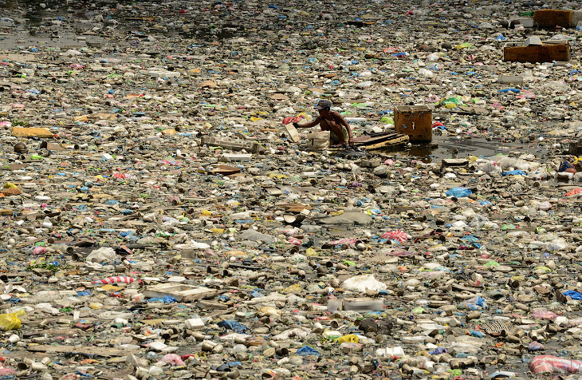
Houston, we really have a problem

Slide 10
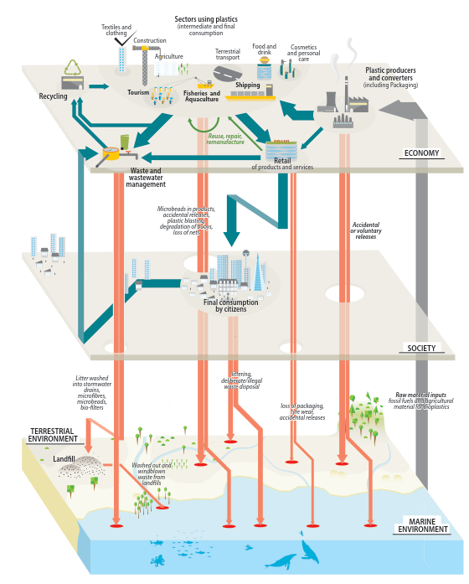
80% of Marine litter comes from the land
80% is plastic

Slide 11
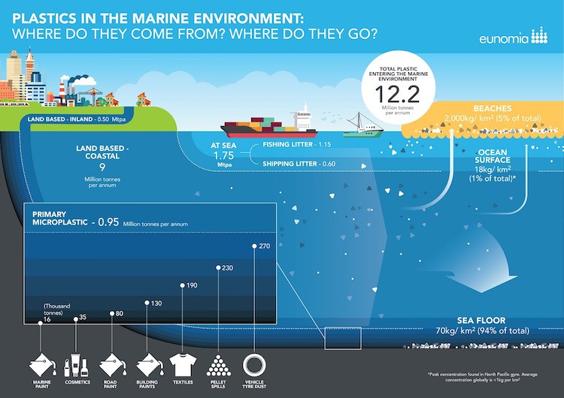
94% of plastic lands on the sea Floor!
Coming back in shrimps, fish, sea salt… on our plates!!

Slide 12
Plastic op drift. Antwerpen op dreef.
We had a big congress last week (22 September 2017) and launched a campaign
In Dutch.
  Pressure on higher levels Flanders
  seeking partners in local governments.
Translate?
  Congress: PLASTIC ON DRIFT. ANTWERP ON SPEED.
  Campaign: “Clean neighbourhood. Quick money”.

Slide 13

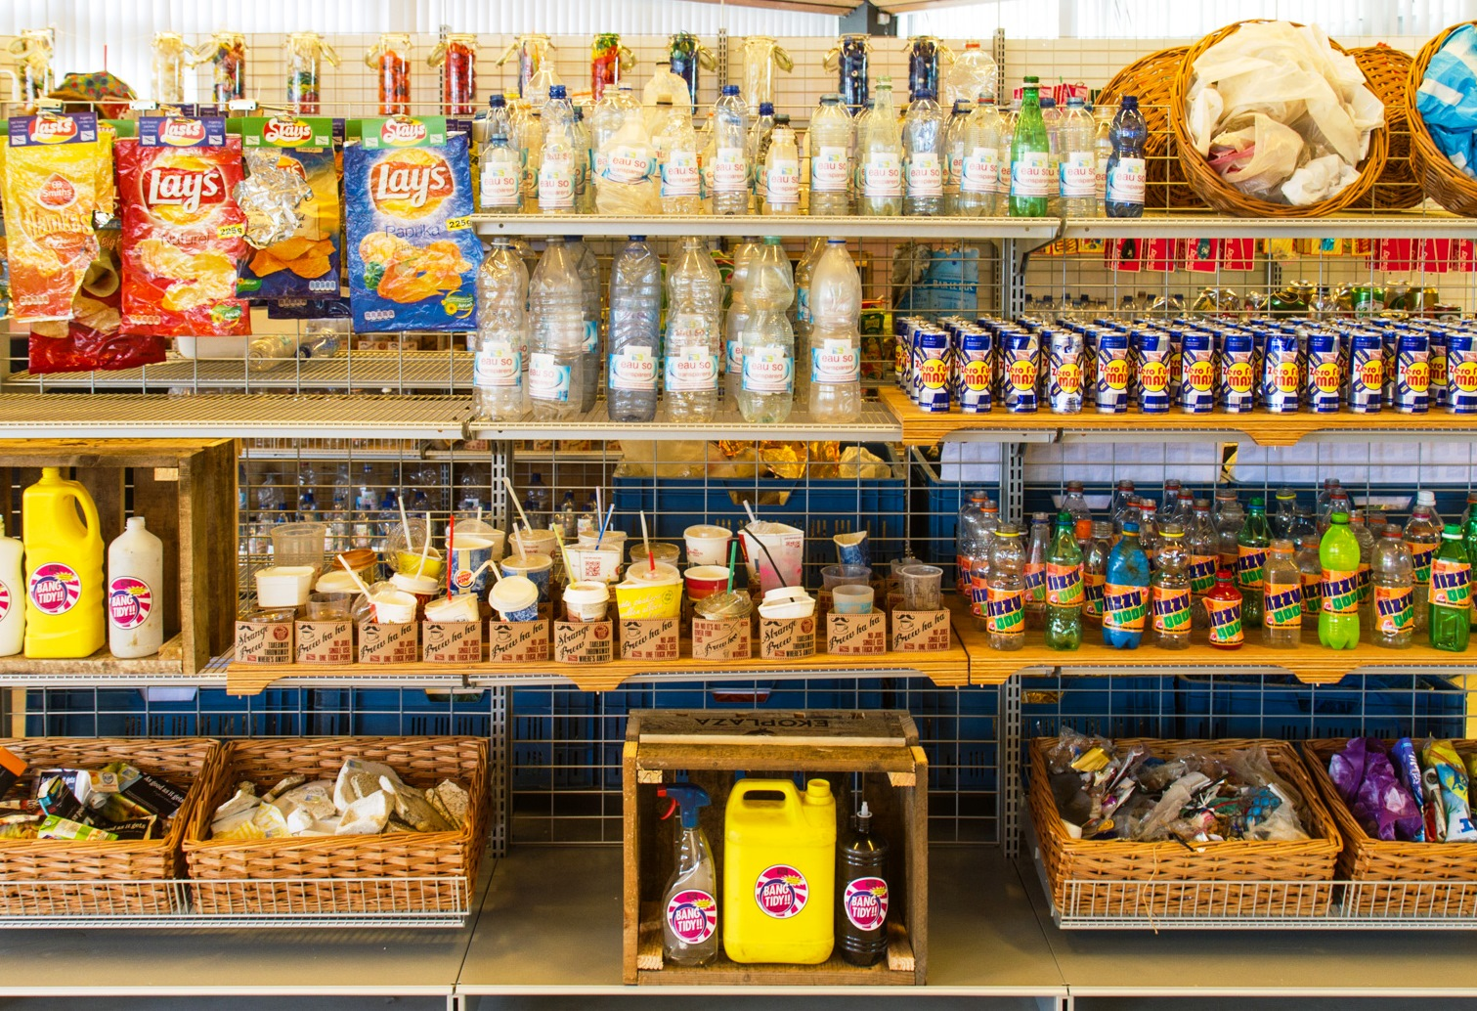
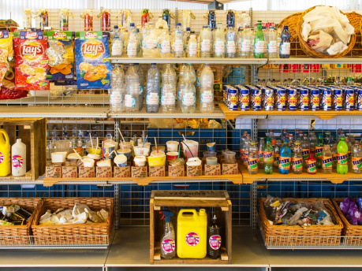
Citizens step up battle against illegal dumping
by Alan Hope,
Local organisations in Antwerp have committed to tackle fly-tipping
Charter signed
Seven associations in Antwerp have signed a charter with the city committing them to work to keep their neighbourhoods clear of fly-tipping.
The project in Borgerhout and Antwerp-North aims to tackle the illegal dumping of rubbish, from household garbage to furniture to construction waste, and also involves a premium for drinks packaging collected.
It was launched during a conference about fly-tipping in general and plastic waste in particular, which included screenings of the British documentary A Plastic Ocean, which illustrates the environmental consequences of plastic in the seas and in the food-chain of marine wildlife.
Clean-up services in Antwerp collect 5,400 tonnes of illegally dumped waste every year, at a cost to the city of €25 million. A large part of the waste finds its way directly into the Scheldt river via the sewers, waterways and the wind.
About 70% of the waste is plastic. Worldwide, annual dumping of plastic waste amounts to an estimated 10 million tonnes. The event also included a display of the Plastic Soupermarket project, a supermarket display made wholly of plastic objects collected from waterways (pictured).
One tiny article in English

Slide 14
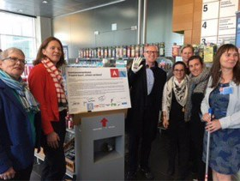
http://www.gva.be/cnt/dmf20170922_03087726/project-propere-buurt-schoon-verdiend-gaat-van-start

Slide 15
What can cities do ?
Prevention as always is the best…
(Green) events regulations
Ban plastic sacs, ban plastic bottles??
Availability of free public drinking water in parks f.i.
Set up own deposit system? (That’s kind of what Antwerp is doing).
Nudging?
  Copenhagen
  …

Slide 18
Can Smart Technics help?
Yes !
But…
Kafka is everywhere and architects are his disciples…
From Operational side it is a big fight !
  (if politics don’t listen to what matters)

Slide 19
The stations of the cross of … BB
2007 first trial BB – positive on operational level.
  Architects: Ugly! NO! Council followed them.
2011 tender, with architects, evaluation, scoring with architects
  on agenda council – Withdrawn – Ugly - NO!
2014 tender without architects, for green parks
  (architects missed it)
2015 first BB in green parks
  (architects pissed off!!!)
2016 Our Major on visit in Seoul! Waauh Smart Bin (a –bad- clone)…

Slide 20
Smart Bins in Antwerp
2016: why not in shopping streets (citizens, local politics…)
  “smart” question !
2017 first BB in shopping streets (see first photo’s)
  (architects furious !!!)
We will not replace all bins by BB. From 2018 out rolling BB in
  the 8 Former independent communities centre (now districts)
  some other shopping centre.
  Touristic “highway” from Central station – City Hall – River
  Mobile ones for events ?
We will test WIFI for public on BB
  Solar energy: specially for parks interesting

Slide 21
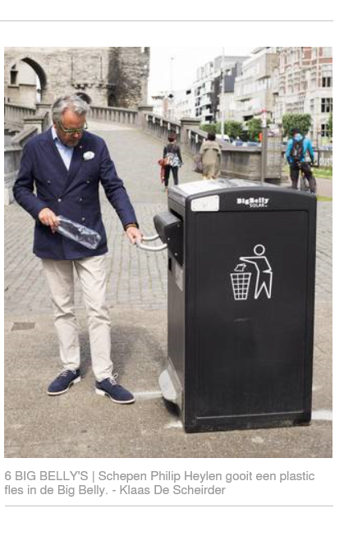
This is that very, very UGLY… thing!
Bhwau!! ???
Note: Citizens of Antwerp DO react on anything.
You know that feeling?
More than 2 years BB: not one complain
about the “ugly” look.

Slide 22
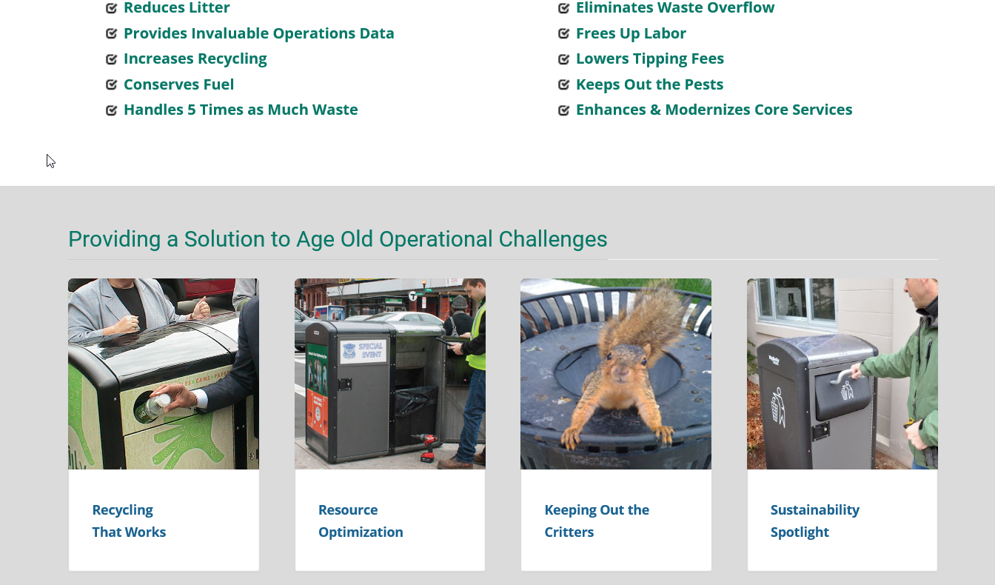
Big Belly – Benefits
120 litres – Compression up to 8 times = 960 litres
Indicates when full – (Clean-software)
Solar energy

Slide 23
120 Big Belly’s
Experience with Smart software BB (Clean) – limited
Parks: all over the city – 3 services/ Shopping street other service
Comparing to other programs (fill level sensors and Smart Planning)

Slide 24
Underground system
The future!! Door-to-door
Big savings + more service
(always can get rid of waste)

Slide 25
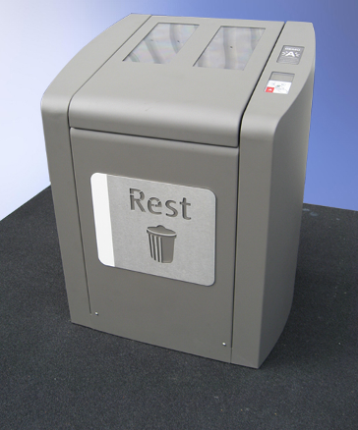
The Antwerp – column
Designed for Antwerp

Slide 26
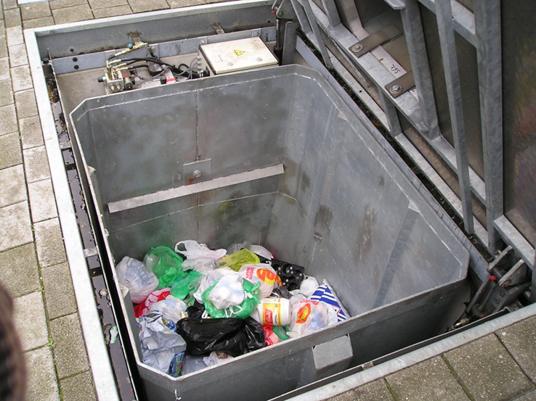
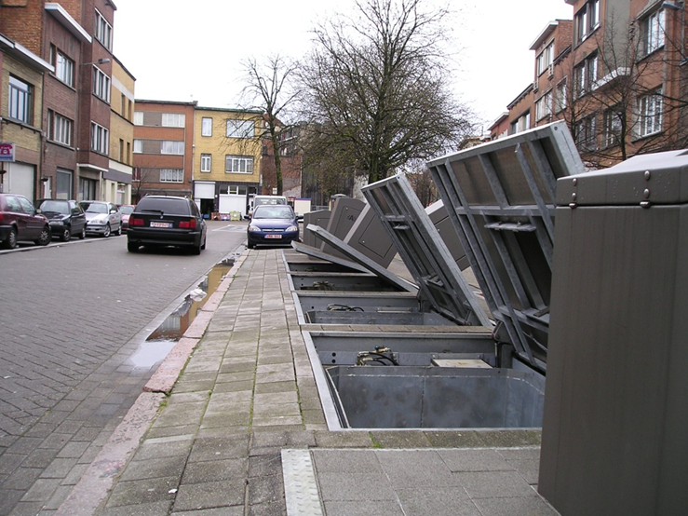
Undergrounds: 5000 litres – 5m³

Slide 27
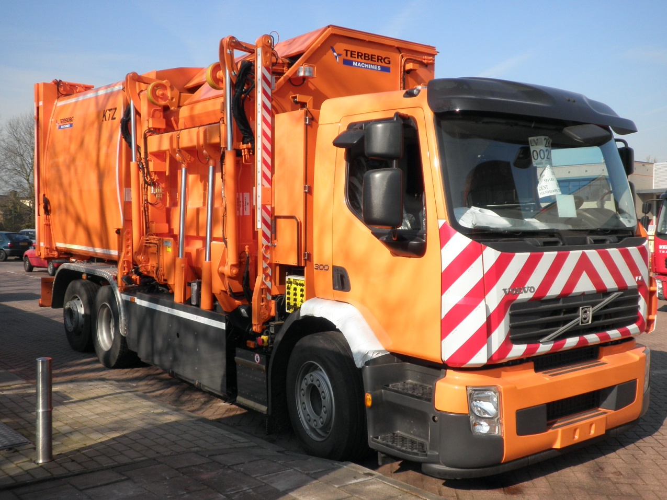
Emptying

Slide 28
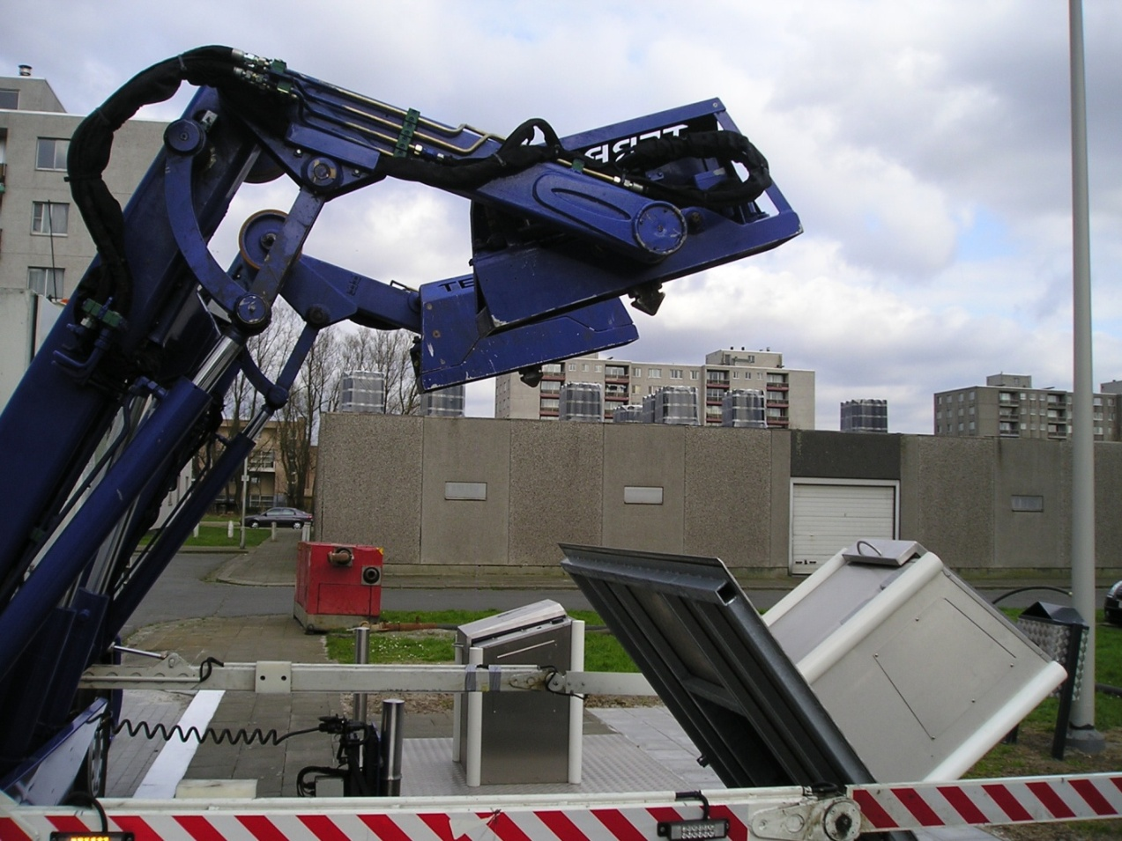
Emptying

Slide 29
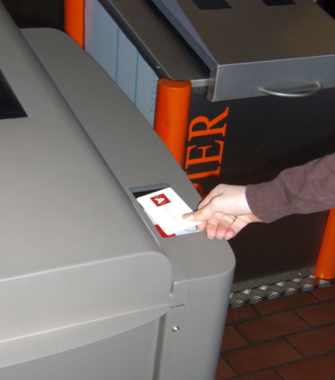
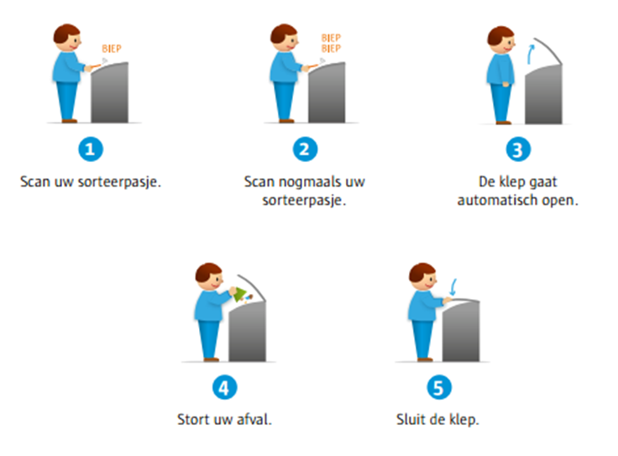
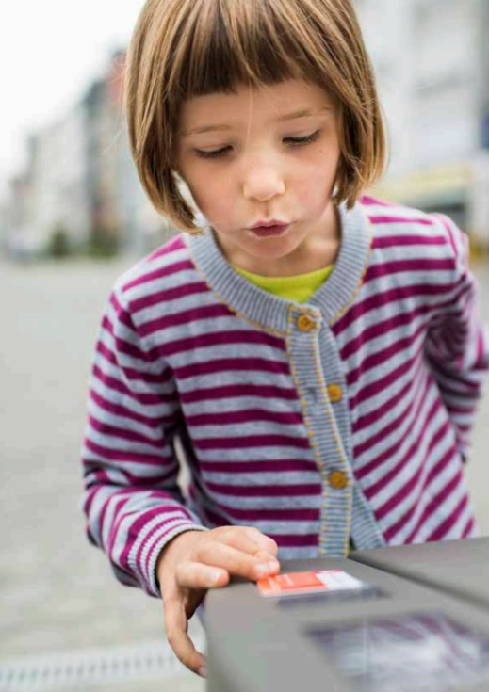
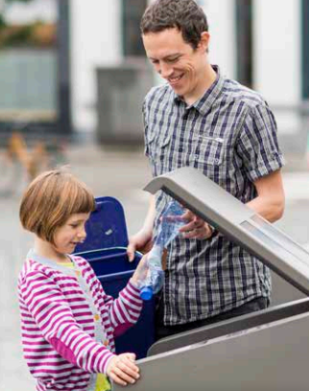
Easy… A child can do

Slide 30
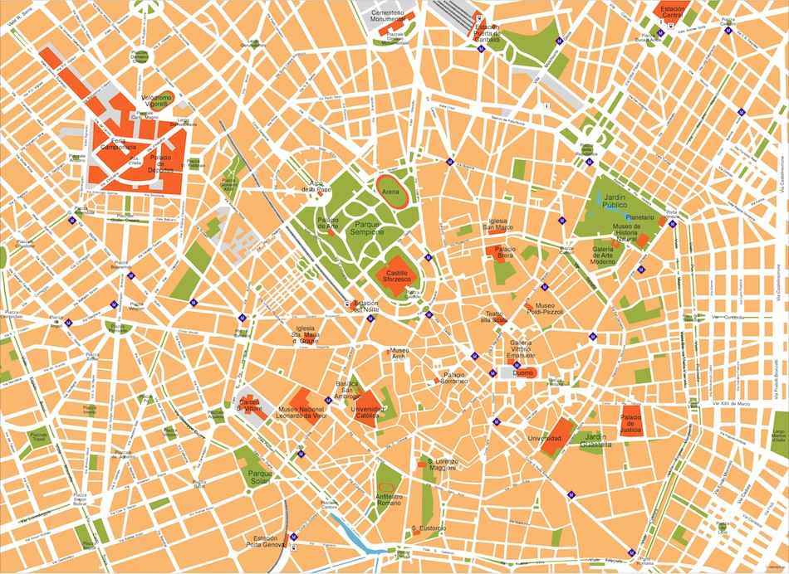




?
?
?
?
?
?
?
?
?
?
?
?
?
?
?
?
?
?
?
?
?
?
?
FROM: Static routes and schedules –
Driving “blindly” from bin to bin
Notes:
Why does this happen -> they are driving “blindly” from container to container
Example cost calculation:
109 km driven
3 h 5 min (labor

Slide 31

64%
16%
33%
100%
16%
62%
29%
41%
32%
36%
70%
53%
8%
87%
44%
93%
25%
78%
40%
36%
56%
47%
TO: Accurate Data driven dynamic routes
- Effective & efficient collection
Notes:
Example cost calculation:
32 km driven
57 minutes (labor)

Slide 32
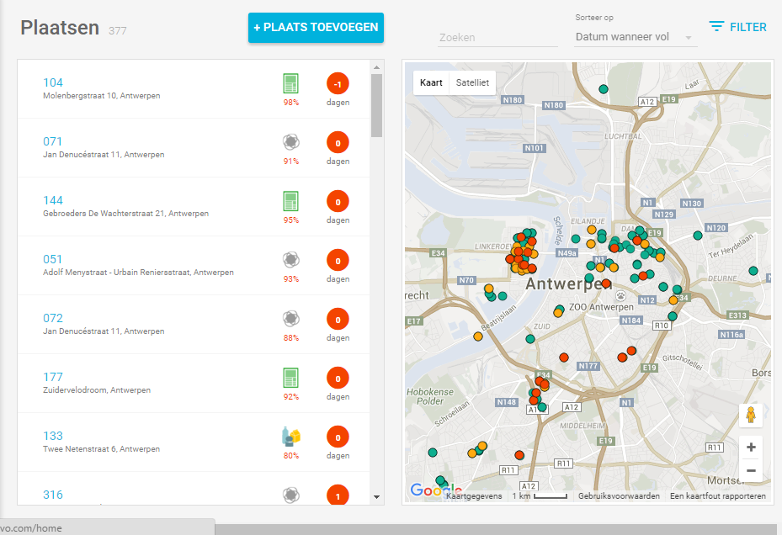
Software

Slide 33
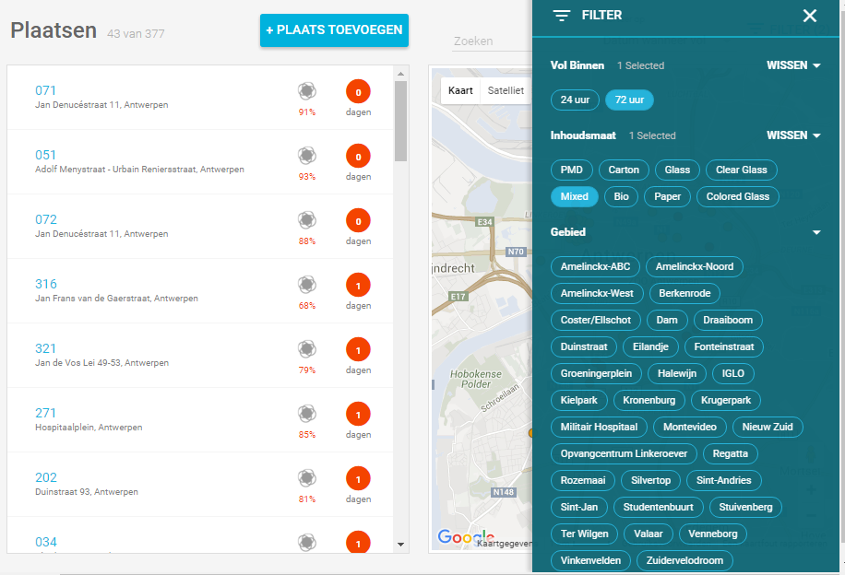
Software

Slide 34
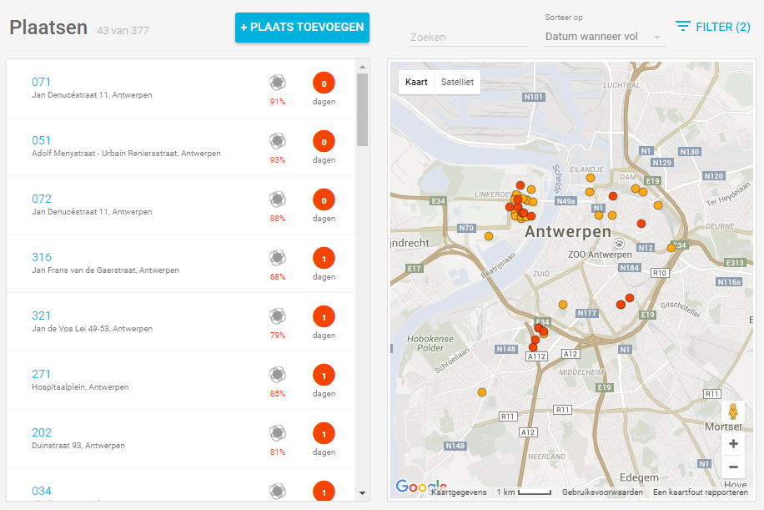
Software

Slide 35
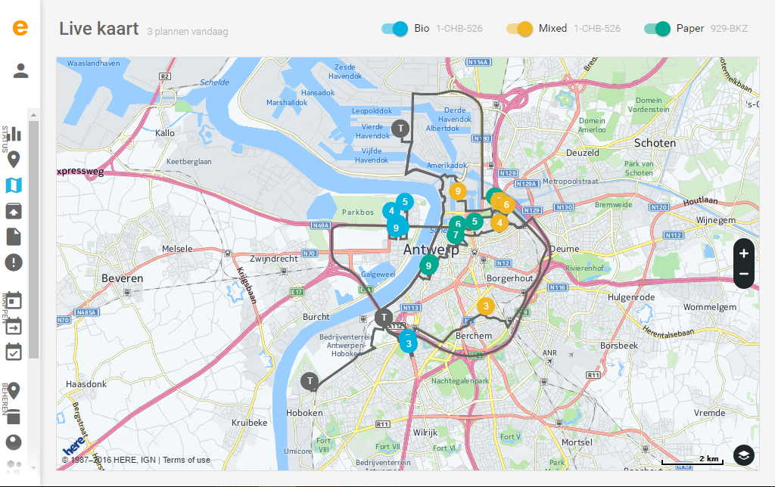

Slide 36
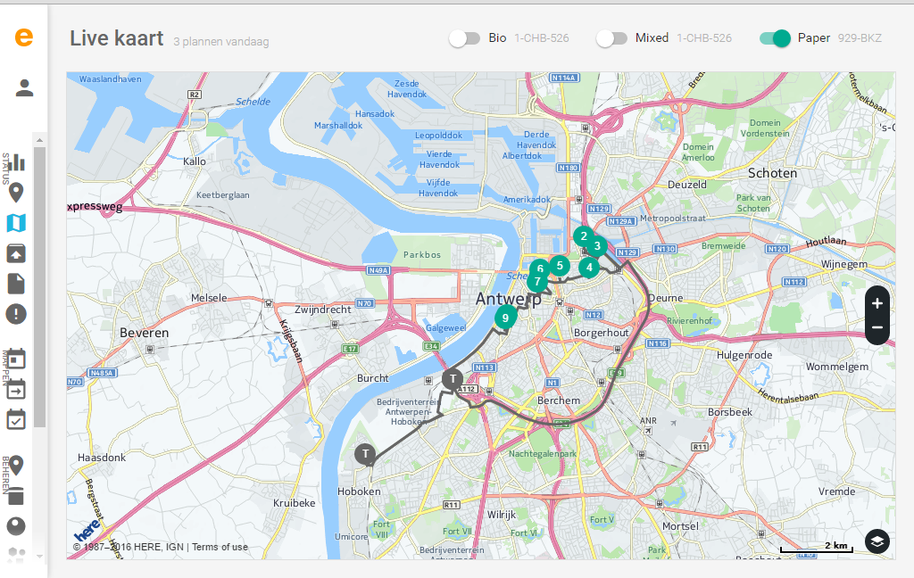

Slide 37
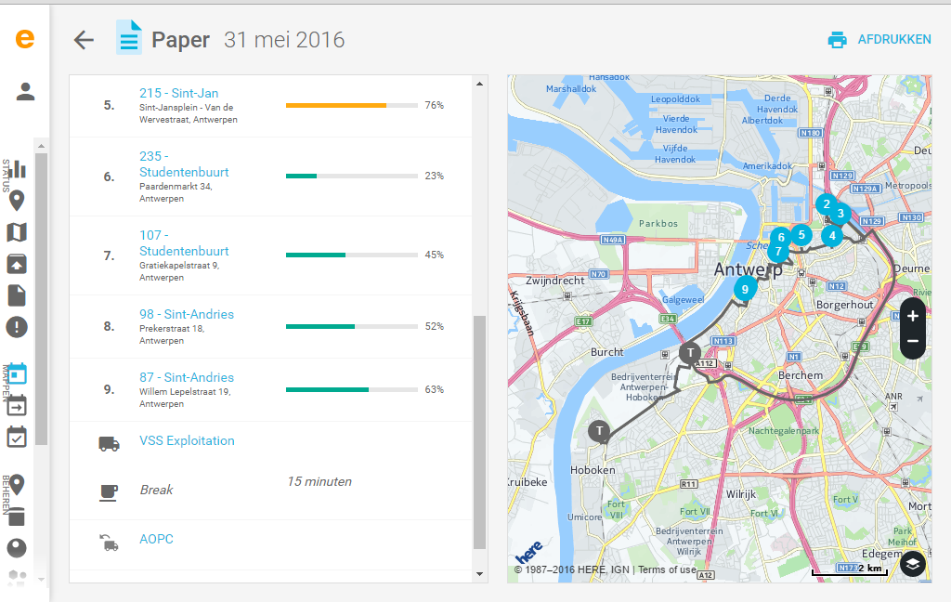

Slide 38
Kafka & Conclusions
I didn’t mention but he was every where again
Drivers know always better – it is their job!
  Bullshit !!!
Human brains have “difficult” to understand algorithms
  Fill degree 60% is not equal 60%: prediction when emptying is needed (Forecast)

Slide 39
Kafka & Conclusions
We skipped three new trucks in out rolling the underground system. (Keep working with five).
  Savings 60% on trucks and drivers.
We aspect the same kind of wins by rolling out the BB.
Politics: Be brave! Go forward!
Civil workers: don’t give up, be Smart (as a bin)

Slide 40
Coordinates/ info
Policy Advisor Innovative Waste in a Circular Economy.
  Luc.derooms@stad.antwerpen.be
      Tel: + 32 3 338 14 45
      Celphone: +32 499 80 22 26
  Public: http://www.antwerpen.be
Linkedin: Luc De Rooms

