Slide 1
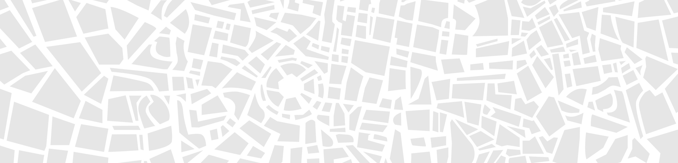


I National Conference of Urban Cleaning – Challenges to Smart Cities
CITY OF MILAN ENVIRONMENTAL ROADMAP
Oltolina Marco - Cascais, 29/09/2017

Slide 2



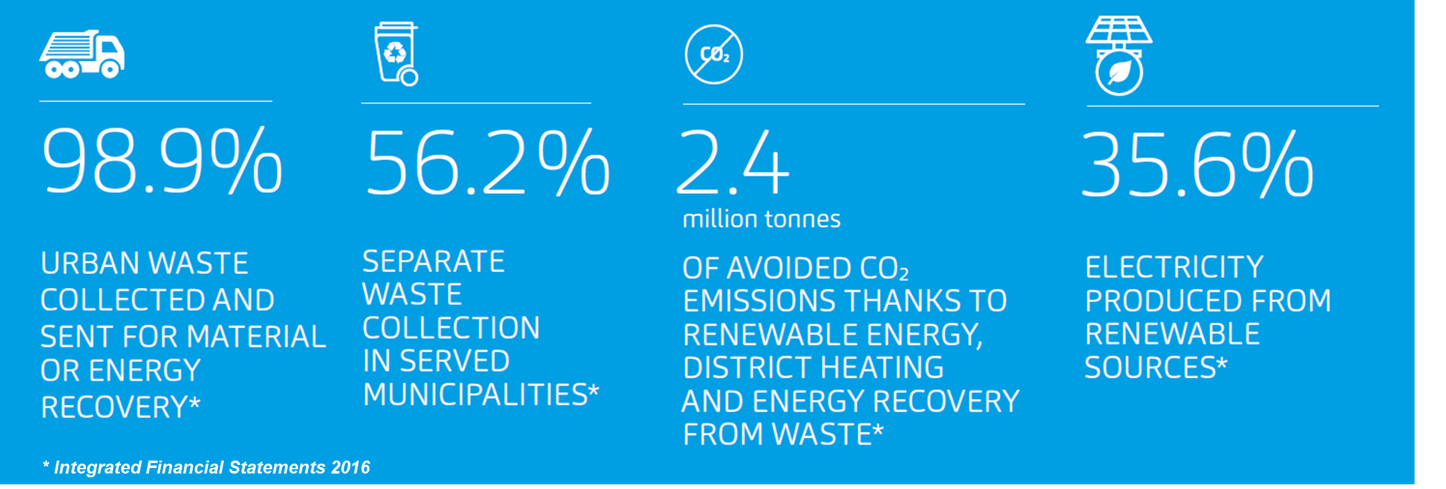
A2A GROUP
Company profile
A2A Group was created in 2008 by merging the municipal companies of Milan (Milan AEM and AMSA) and the one of Brescia (ASM Brescia).
Currently is the largest Italian multiutility, leader in the energy, environment, heating network and smart city sectors.
Everyday, we bring light, heat, water and efficiency into people’s homes, we offer essential services and are committed to designing the towns and cities of tomorrow with innovative technology.
A2A
ORIGINS
2008
A2A NATIONAL DEVELO-PMENT
2017

Slide 3

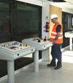
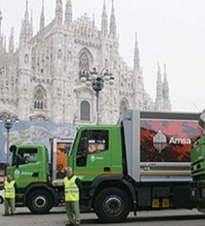
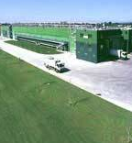
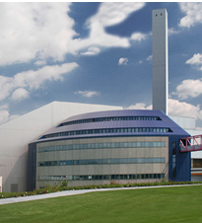
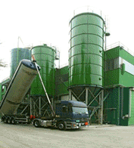
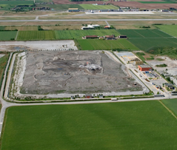
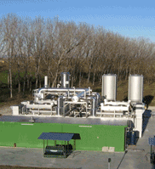



AMSA AND A2A GROUP
Waste Business Area
TREATMENT AND DISPOSAL
ENGINEERING
COLLECTION
TREATMENT
WASTE TO ENERGY
RESIDUES
AND ASHES
LANDFILLS
EE & BIOGAS PRODUCTION
R&D, engineering, building and sale of treatment and disposal plants
Waste collection and street cleaning in over 160 municipalities
Selection, MBT(1) and organic fraction separation, composting, other treatments
Waste to Energy plants: management of the three bigger plants in Italy
Treatment of Residues and Ashes from WTE’s, their stabilization and environmentally-friendly use
Landfill management only used where the waste are not reusable 0.1% of cases
Electricity production from biogas (>40 GWh)

Slide 4
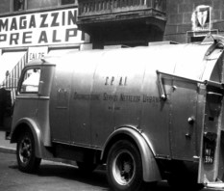
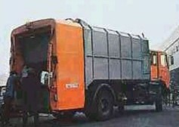
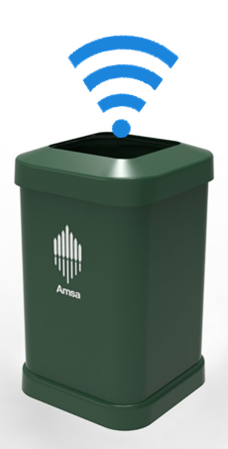
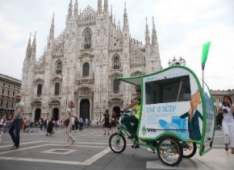
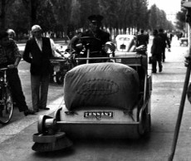
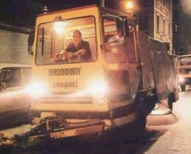
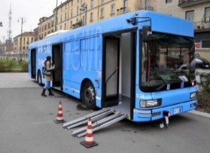
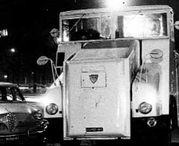
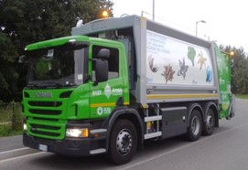
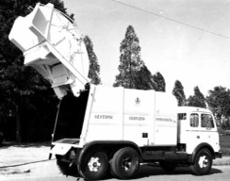
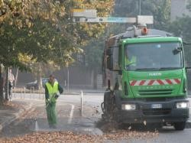
AMSA
Over 100 years of history
Amsa has been active for over 100 years in the urban waste collection, disposal and hygiene. Currently the company manages the services for the City of Milano and 12 other municipalities in the metropolitan area, for more than 1.6 million inhabitants served.
1929 - 1951
S.P.A.I.
1970 - 1984
From 2008
1952 - 1958
A.M.N.U
Amsa joins
A2A Group
Duomo S.p.A.
1907
1950
1990
2017
1952- 1954
G.S.I.
1985-2007
1955- 1969
Amsa S.p.A.
S.I.D.

Slide 5
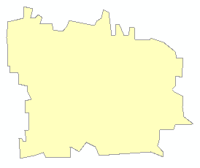

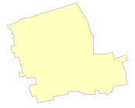


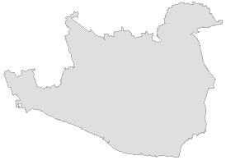
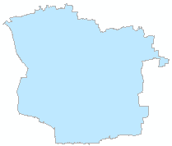



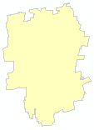
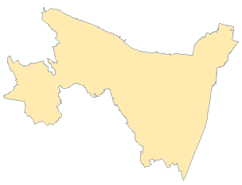
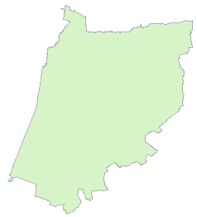
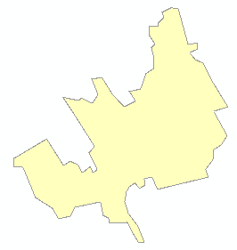


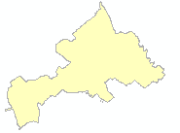
THE CITY OF MILAN
Served area and critical issues
The City of Milan
1.3 milion inhabitants
  2,200 t/day MSW
182 Km² area
2,000 Km of streets
3,200 employees
1,400 vehicles
55,000 collection points
23,000 street bins
5 civic amenity sites and 2 mobile Eco centers
Critical issues
High population density
  7,200 inh./Km²
Streets and traffic
  Lack of space
  Rush hour traffic and illegal parking
Commuting
  800,000 commuters every day
Plants, logistic facilities
Civic Amenity sites

Slide 6


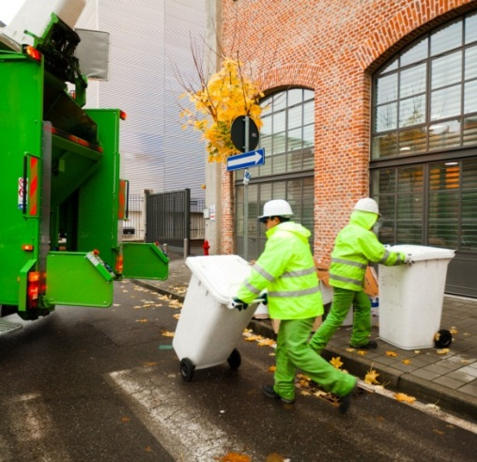
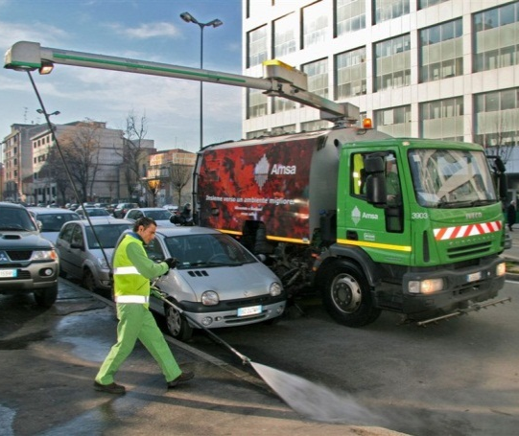
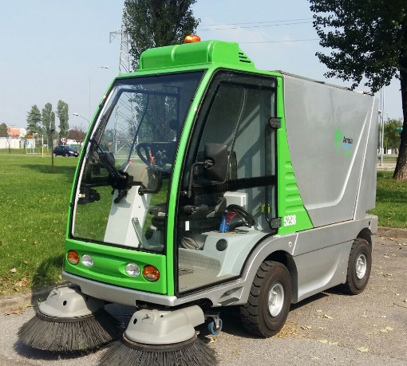
WASTE COLLECTION AND STREET CLEANING
Delivered services in Milan
Door to Door Waste collection
Street cleaning
Waste collection 671,326 t/year 2016
52,4% Recycling
  352,292 t Total recyclables
    79,500 t Paper and cardboard
    43,466 t Plastic and metals
    65,298 t Glass
    139,709 t Organic
    24,646 t Other
  319,283 t Residual waste
2,185 Km of streets to clean (4.370 Km for both sides of the road)
2,800 parks and gardens
23,000 street bins
94 open street markets weekly
Other services: cleaning embankments, street and sidewalk weeding, drain wells, emergency management and major events, graffiti removal, mobile toilets, winter services, disinfestation, etc...

Slide 7



INNOVATIVE TECHNOLOGIES
Smart technologies for a smart city
SMART BIN
Patented technology solution for real time monitoring of containers active in Milan. By December 2017 is expected the placement of 300 smart bins (for a total of 16,000 containers by 2018)
T-RICICLO
The first solar powered cargo-bike with pedal assist system for the collection of wastes.
SWEEPY JET®
Sweepy Jet is a patented equipment for cleaning the streets and sidewalks without moving the parked cars
CENTRAL CONTROL ROOM
Monitoring information and detecting critical issues in the area and share them with the local Operating Units
Supporting the operating units in the management of events
Interacting with local Institutions
Providing an overview of all the delivered services in the area
FUTURE PLANTS
The development plan for the next three years include: 2 installations for the selection of multi-material (plastic and metal packaging) and 2 anaerobic digestion plants for the organic fraction of municipal waste

Slide 8
INNOVATIVE TECHNOLOGIES
Bins emptying issues
The street bins emptying process in a big City, is not averse to a number of challenges and potential pitfalls.
Often, in the suburbs, street bins are being collected before they are full, while in more crowded areas bins tend to fill quickly and need to be emptied more frequently.
In Milan, the frequency of collection can vary from once a day in suburbs, to more than three times a day in more crowded areas.
To make sure that citizen’s and Municipal Administration demands are constantly met whilst ensure that waste collection remains both proficient and cost-effective, meant that waste collection need to become smarter.

Slide 9

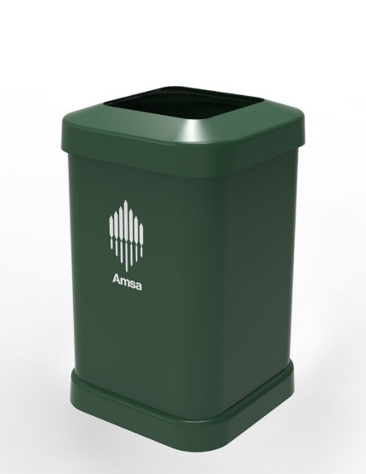
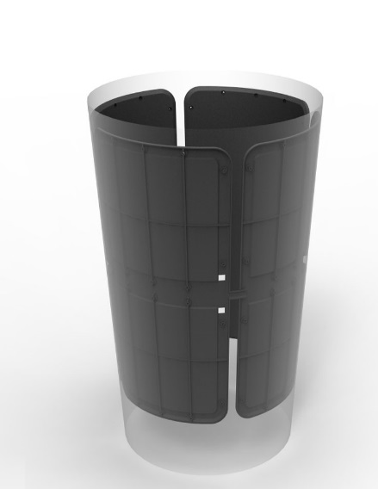
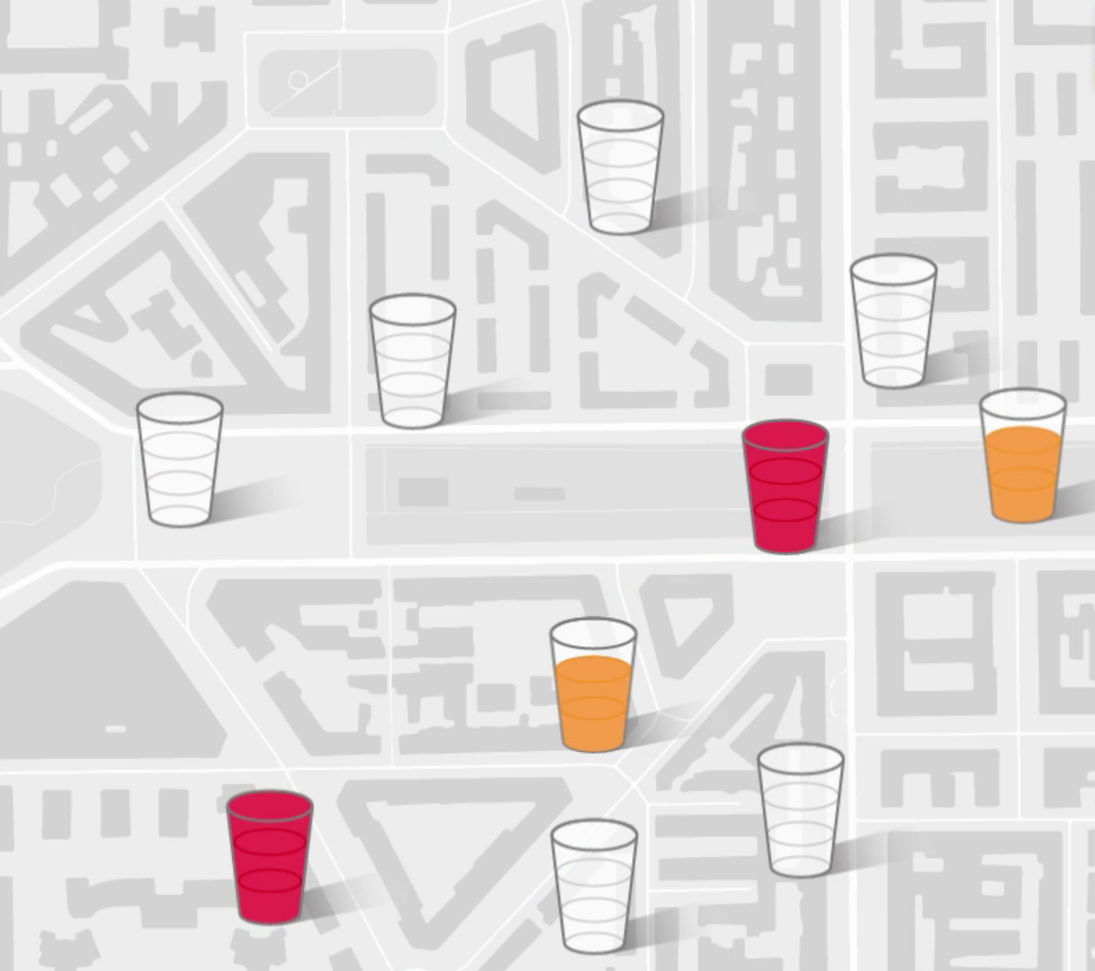

SMART BIN
Project Overview
Amsa, in collaboration with Cefriel (a digital innovation company based in Milan), developed a patented technological solution, able to automatically and continuously detect the filling level of street bins and to communicate it to a data processing and analisys center.
Key findings
Optimization of emptying processes, with less use of workers and vehicles
Reduced environmental impact through efficient logistics
Identification and geolocation of street bins
Increased service flexibility based on the actual filling of the containers
Using innovative technologies based on distributed intelligence scenarios
Improvement of the city's decorum and process certification
Enhancement of the corporate image
Smart Bins in a nutshell
16.000 street bins by the end of 2018
Connected to the A2A Smart City LoRa WAN network
Improvement of efficiency and quality of service

Slide 10
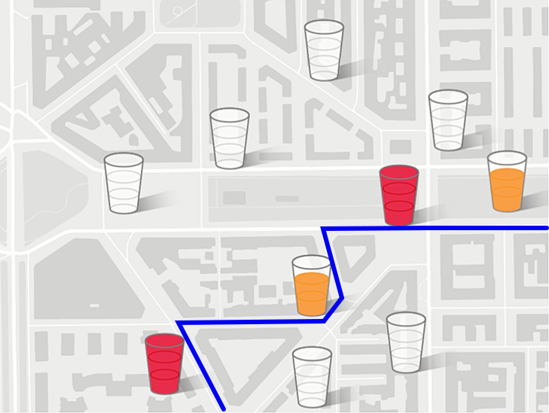






SMART BIN
Benefits
Thanks to the real-time data received from the field, is possible to build the routes optimiziotion process and to distribute, allocate and maintain litter bins based on data trends collected over time.
In addition, it allows them to certify waste removal with time indication, track the activity of its employees, monitor damages caused by vandalism and enable value added services using sensor networks. And just as important, citizens receive a better quality service and benefit from a cleaner and tidier environment.
Real-time Info to Operators
Real Time Info to Management
Back-end System
Citizen
Third Parties Systems

Slide 11
SMART BIN
The evolution of smart bins
Amsa and Cefriel started to develop a smart bin in 2009 before the Internet of things (IoT) and Low-Power Wide-Area Networks (LPWAN) became more mainstream.
The very first prototype had a GPRS/3G radio and a very simple back-end system.
2009
2010
2011
2015
2016
2017
2018
Feasibility study
First prototypes
1 year field trial of 10 prototypes
Field trial during the EXPO 2015
Preparation and publication of the call for tenders
Engineering and pre-series (300 units) development
Production and commissioning

Slide 12
SMART BIN
The product
Currently the smart waste collection solution includes:
low unit cost, enabling bins to be deployed at scale (a thousand or more units)
robust design, the bins have a life span of several years with little or no maintenance
low impact on bin handling and appearance (citizens and collection teams are familiar with the current form of the bins; this feature avoids disruption)
low cost and low power wireless connectivity
a robust and scalable back-end system which can be integrated with other systems with the option to easily develop new features.
The smart bin can now detect how full it is via an innovative and patented technology based on capacitive sensors applied to the bins.
Combining this sensing technology with the data transmission over LPWAN will deliver longer battery life at a lower cost.

Slide 13
SMART BIN
The technology
The sensing technology uses an innovative and patented approach (EP2516974 - EP2721377 AMSA and Cefriel) based on the electrical capacity variation between the plates of a sensing level in the presence of wastes.
The electronics inside the box stimulate the plates and perform the measurement. An algorithm allows to define the full / empty state from the measurement.
The top occlusion condition is detected by two auxiliary optical sensors.
Sending data from the container to the Data Collection and Processing Center takes place via the LoRa WAN network or, if necessary, through the traditional GPRS network.
Top occlusion sensors
Box
Filling level estimation sensors
h2
Electronics and batteries
Filling level estimation sensors
h1
Wiring (not visible)

Slide 14


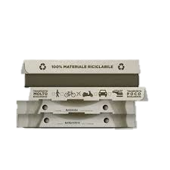
SMART BIN
Project Overview
With two levels of plates, three basic states of the container can be detected:
EMPTY
FULL UNDER
FULL (FULL OVER)
The top occlusion condition is detected in the presence of light by additional sensora and is not correlated to the fill level. From its sensor, two status conditions are obtained:
OCCLUSION DETECTED
OCCLUSION NOT DETECTED
EMPTY
FULL - UNDER
FULL (FULL – OVER)
OCCLUSION

Slide 15
SMART BIN
Roadmap to final product
Task
2016
2017
2018
2019
1 Qr
2 Qtr
3 Qtr
4 Qtr
1 Qtr
2 Qtr
3 Qtr
4 Qtr
1 Qtr
2 Qtr
3 Qtr
4 Qtr
1 Qtr
2 Qtr
3 Qtr
4 Qtr
Project start-up
Public tender
300
Product engineering and pre-series
16.000
Industrial production and placement
Development of route management SW
Planned Task
Completed Task
Extra-tender activity

Slide 16

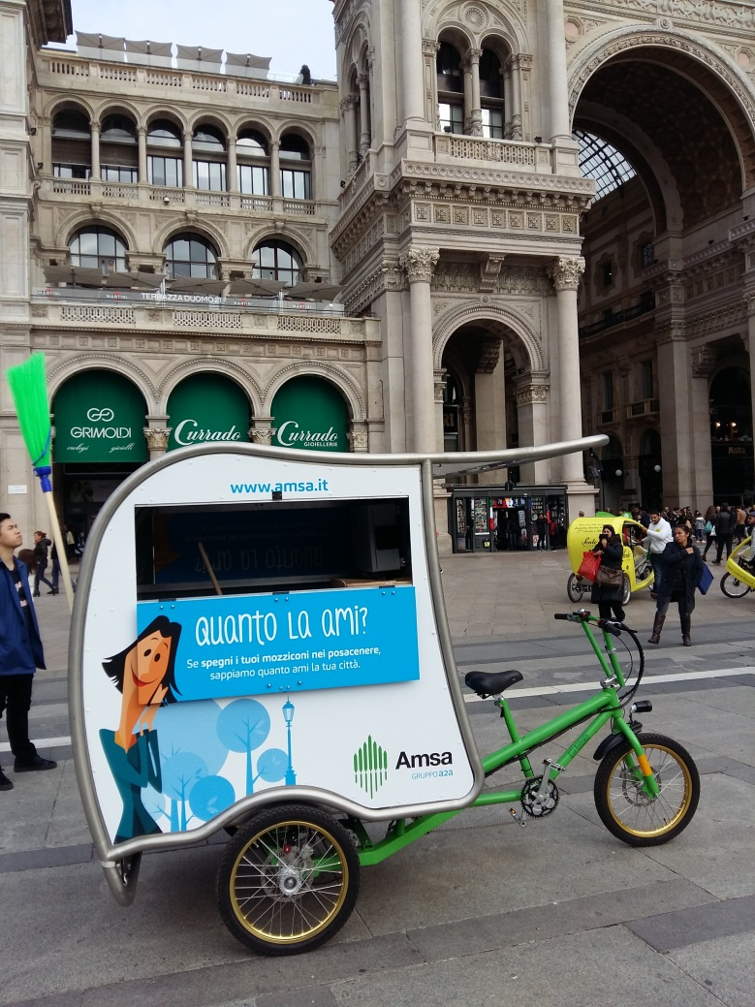
T-RICICLO
A new ecofriendly and smart cleaning service
City of Milan: 12 Tricycles – electric pedal assisted cycles
Light, versatile, multifunctional vehicle.
Zero emissions. It is environmentally friendly as it is equipped with photovoltaic roof panels
Cleaning service that can partially replace the cart sweeper
Side panel equipped with communication campaigns "how much do you love it?" against cigarette butts, incorrect use of street bins and illegal dumping in the City.
Ready for additional sensors equipment (air quality monitoring, traffic control, ...)

Slide 17
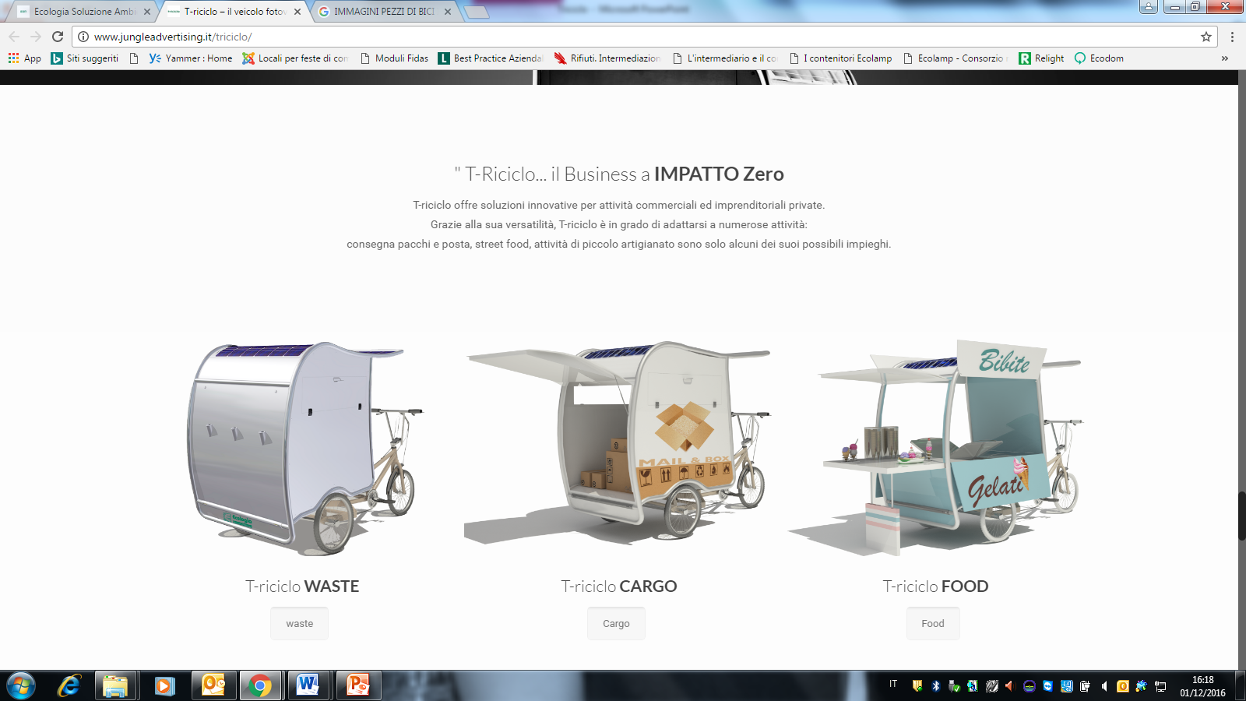
T-RICICLO
Overview
T-Riciclo is the first pedal assisted e-bike with photovoltaic panel.
It is a new technology solution (developed by Ecologia Soluzione Ambiente) tested during the Expo 2015 and the rolled-out during the first half of 2017, born to to improve the efficiency and effectiveness of the street cleaning service.
Renewed the constant and capillary garrison for the maintenance of urban hygiene throughout the city.
It moves quickly and freely in restricted traffic areas, pedestrian areas
Ecological, easy to use, versatile and multifunctional, with a payload of 250kg.
PHOTOVOLTAIC PANEL
Generated power output: 250W
3 DRIVING MODES
Economy – Normal - Turbo
PEDAL ASSIST SYSTEM
KERS regenerative braking
ONBOARD COMPUTER allowing 5 speed gears variations and power level setting

Slide 18
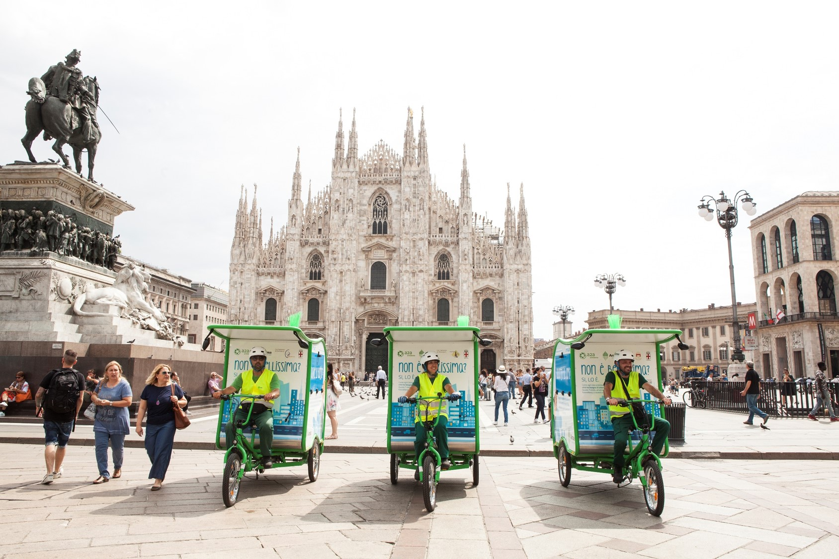
T-RICICLO

Slide 19
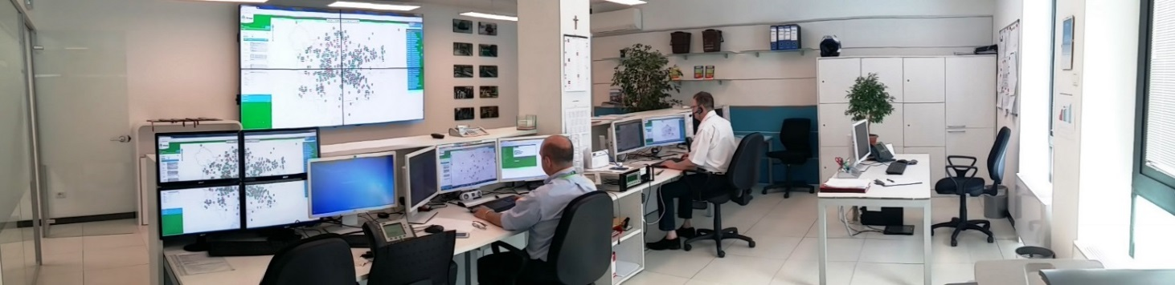
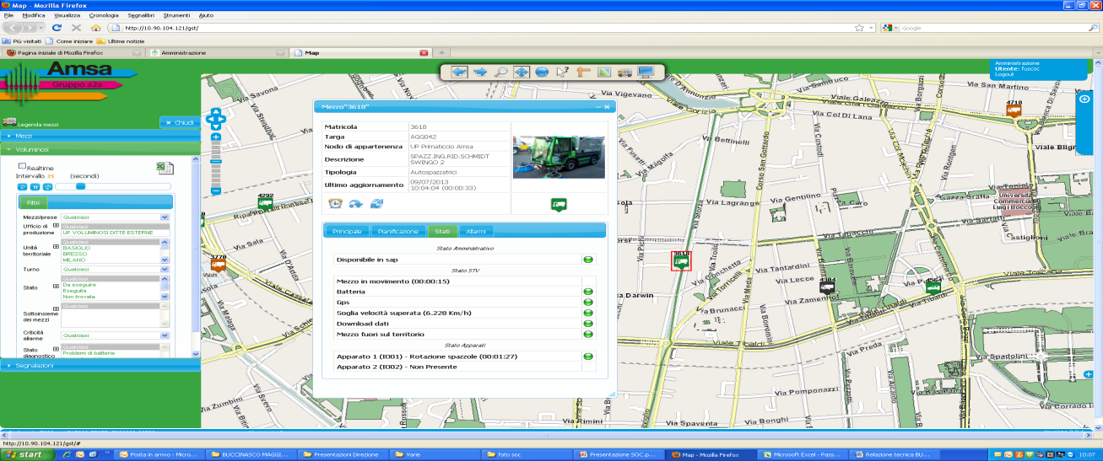
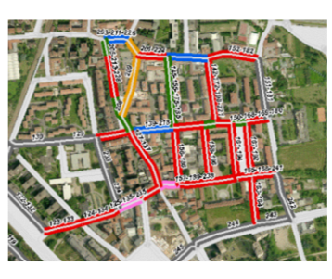

CENTRAL CONTROL ROOM
Overview
Central operation room and territorial management services (TMS): system integration and display of on-line information based on the Vehicle tracking system (VTS): detection of positions and characteristic data

Slide 20




APP "PULIamo" for smartphones
PULIamo is the free application that guides citizens, AMSA users, in the world of waste and cleaning services.
In any place and at any time, you can:
report environmental degradation (filled baskets, syringes, illegal dumping)
Learn the correct methods of waste disposal, thanks to a complete and rapid search engine,
be updated on collection and street sweeping schedule, thanks to a complete and integrated calendar
book household bulky waste and WEEE’s collection
use geolocation to check for nearby bring banks for paper and glass, medicines, clothes, and civic amenity sites

Slide 21
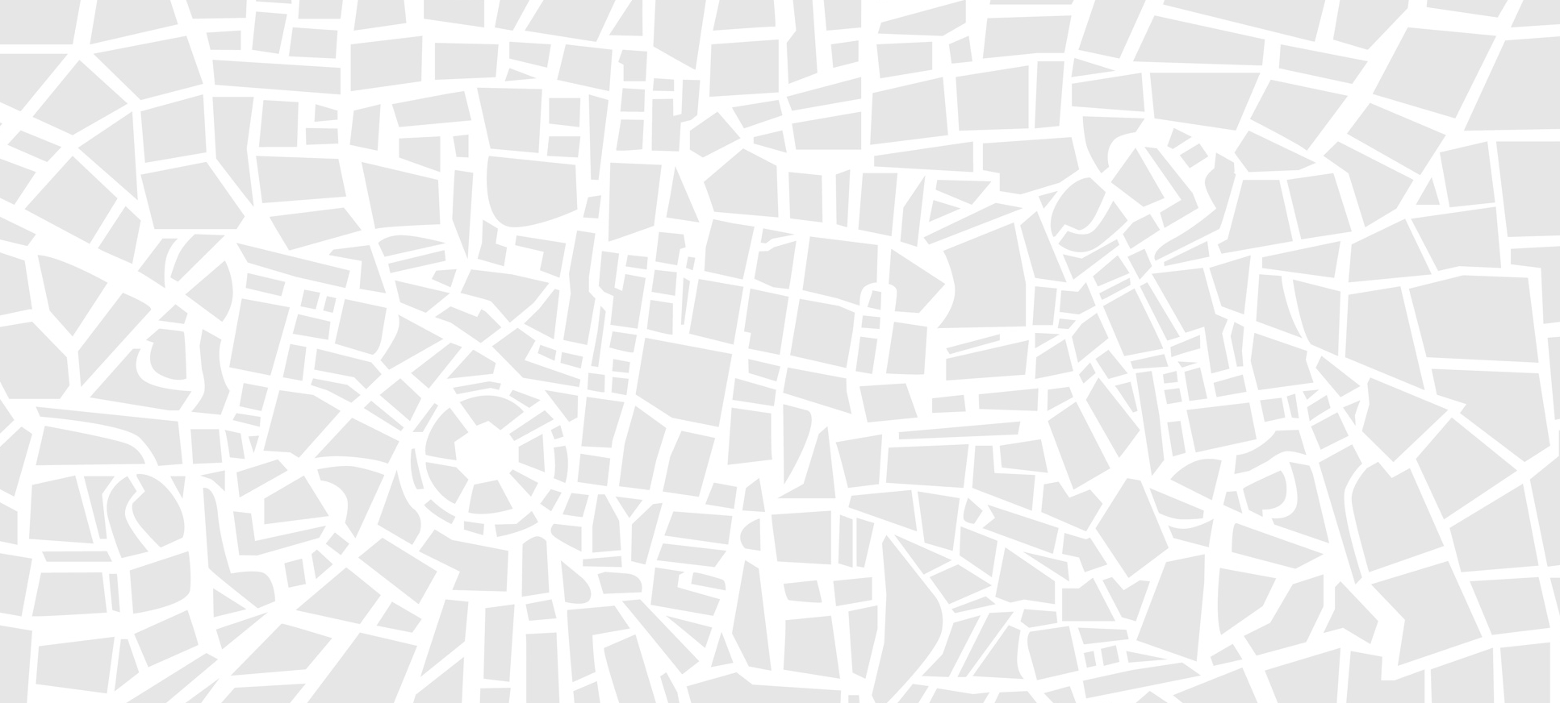
THANK YOU FOR YOUR ATTENTION

